Slide 1
Movie Recommendation System
IT290 Project
Presented By:
Mayur Jinde - 201IT135

Slide 2
Outline
Introduction
Methodology
Dataset
Experimental Results
Future Work

Slide 3


Introduction
Nowadays people are more active on social media, online shopping websites, Netflix, amazon prime and so on. We tend to like things that are similar to other things we like. We tend to like things that similar people like. These patterns can be used to make predictions to offer new things. Recommendation systems involve predicting user preferences for unseen items such as movies, songs or books. Recommendation systems have become very popular with the increasing availability of millions of products online. Recommending relevant products increases the sales through target marketing.

Slide 4
Methodology
Data collection
Data pre-processing
Feature extraction
User input
Cosine Similarity Algorithm
Recommended movie list

Slide 5
Data Collection:
Data pre-processing:
Feature extraction:
User input:
Collecting various details of the movies like the movie name, cast, director, genre etc into an excel sheet.
Processing and filtering the missing data from the csv file.
Converting the textual data to numerical values i.e feature vectors.
User to input his/her favorite movie name.

Slide 6
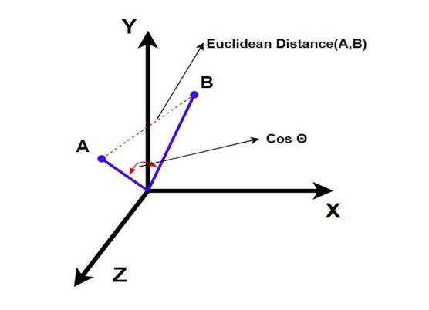
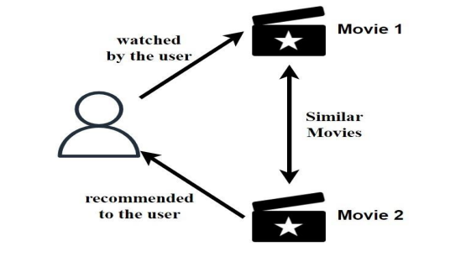
Cosine Similarity Algorithm:
Recommending movie list:
This algorithm is used to find the similarity between the vectors and give the similarity score to all the movies based on the user input movie.
Similarity score ranges from 0 to 1 with 0 being the least similar and 1 being most similar. Cosine similarity matrix is created using cosine_similarity() function present in python’s “sklearn.metrics.pairwise” package. The scores are calculated over the combined_info feature of our dataset which includes genres, keywords, tagline, cast, director of the movies.
Using the similarity score to recommend various movies related to the input movie.

Slide 7
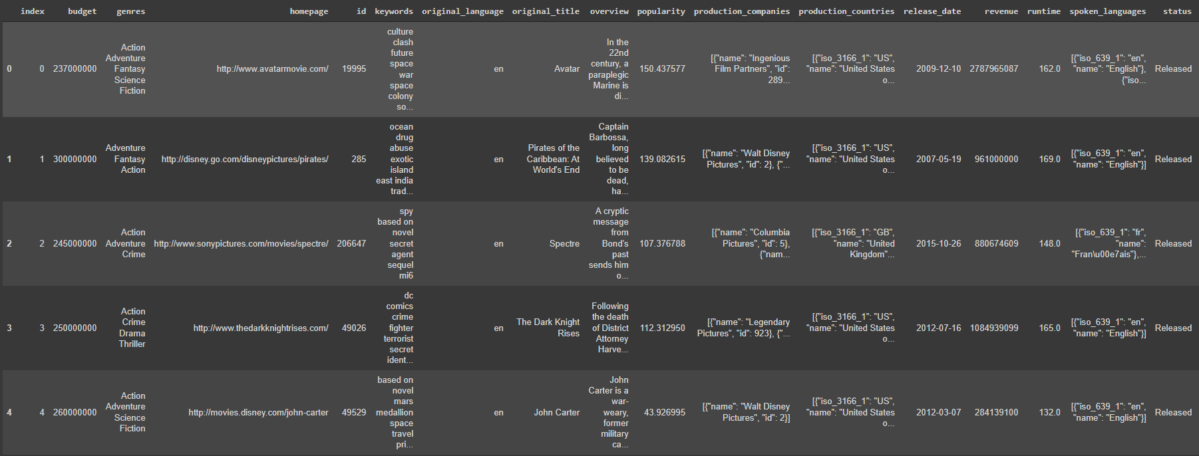
DataSet
The dataset contains a list of about 4803 movies having 24 attributes like movie_name, director, cast, genre etc each.

Slide 8
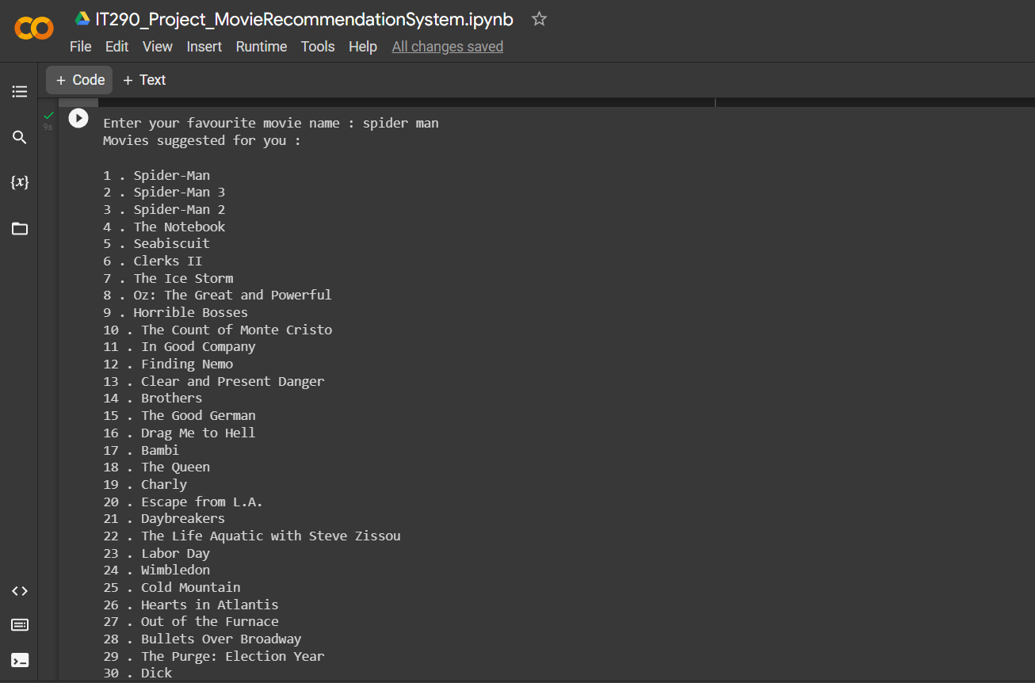
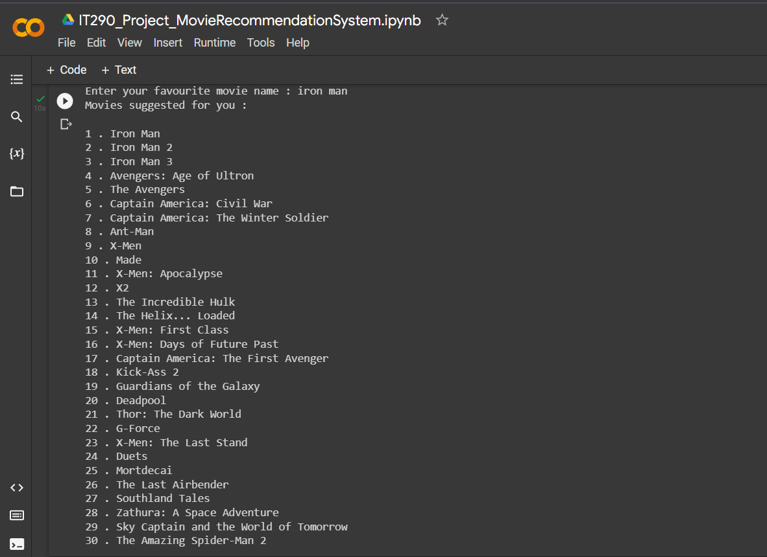
Experimental Results
When the user enters his/her favorite movie, a list of top 30 recommended movie names is given as output.
Click here to view the source code of my project.

Slide 9
Future Work
The future work would be to work on increasing the size of the data set and taking into account even more movie attributes to give accurate recommendations to the user.

Slide 10
Thank You

